Slide 1
From Simulation to Operational
What You Need to Know About the Flow of Student Data
Facilitated by Anne Marie Bertram – NERIC Testing & Data Reports Manager annemarie.bertram@neric.org

Slide 2
Disclaimer
I am a certified NYS District Level Administrator and 7- 12 Mathematics Teacher. I have never been directly responsible in the reporting of student data from the district/school level. All of my knowledge comes from my last 7 years of experience working with NERIC and my colleagues within the Testing & Data Warehousing and the guidance provided by the NYSED IRS and OSA offices.
"Unity is strength... when there is teamwork and collaboration, wonderful things can be achieved."
Mattie Stepanek - American Poet

Slide 3
Objectives
Have a better understanding of the flow of student data from the district to NYSED and back for purposes of CBT Testing
Understand What the NYSED/NWEA Pre-ID is and Why it is used
Understand how OODP/BOCES Students are Populated in Nextera
Understanding the key metrics to a Student Record in Nextera
Understand the RIC/NYSED involvement for students who Transfer
Understand how Student Data is scored, and returned to the districts via DW

Slide 4
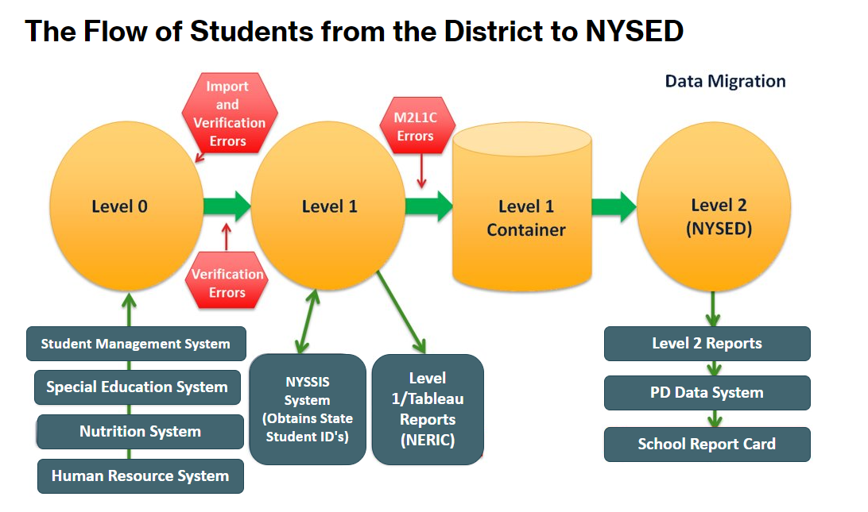
Notes:
This chart provides an overview of the systems that feed from the District to the SIRS.
Level 0 is the base for all student enrollment, demographics, and program services.
Level 1 is the Data Warehouse of the RIC or Level 1 Center
Level 1 container is a "holding cell" where each RIC/Level 1 Center loads data for NYSED Level 2 to grab
Level 2 (NYSED) are the State, leading the SIRS via the Office of Information Reporting Services.

Slide 5
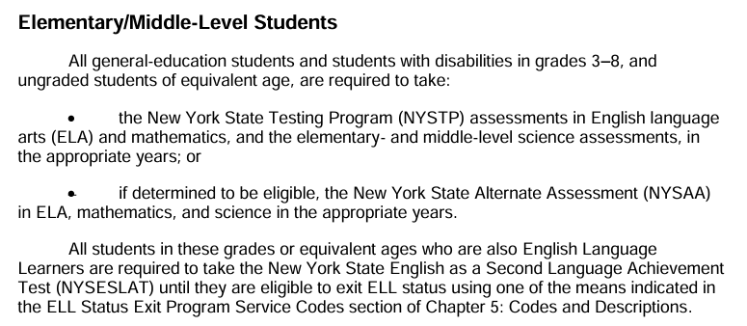
Nextera Pre-ID File
A pull of Student Enrollment, Demographics, and Program Services from the Data Warehouse. Most information comes from the following eScholar Templates:
Student Lite
Student Class Entry Exit
Program Fact – 0220 NYSAA Eligible; 0231/0242 ELL
Notes:
The Nextera Pre-ID File is a pull from the Data Warehouse in a template structure specific for the population of students into the Nextera Admin for purposes of CBT Assessments.
Students who are identified as ungraded, and a program services code of 0220 Alternatively Assessed are omitted from the pull of data
Students with an 0231 ELL Eligible or 0242 First Year ELL are denoted as there are special, allowable testing accommodations and Reason Not Tested codes applicable for these students.

Slide 6
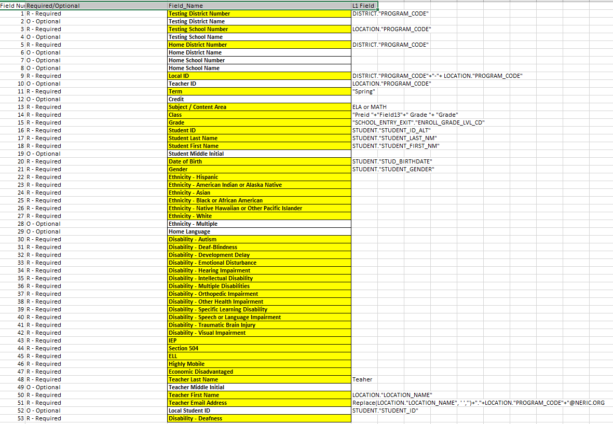
NYSED/NWEA
Nextera Pre-ID File
Notes:
While there are 53 fields within the file, not all are required for population into the Nextera platform.
Ethnicity and Disability fields are binary with Yes/No populated by student. Demographic Subgroups ( ELL, Highly Mobile, Economically Disadvantaged) are also binary fields.
A copy of this sample template can be found in the shared folder resource for this presentation.

Slide 7
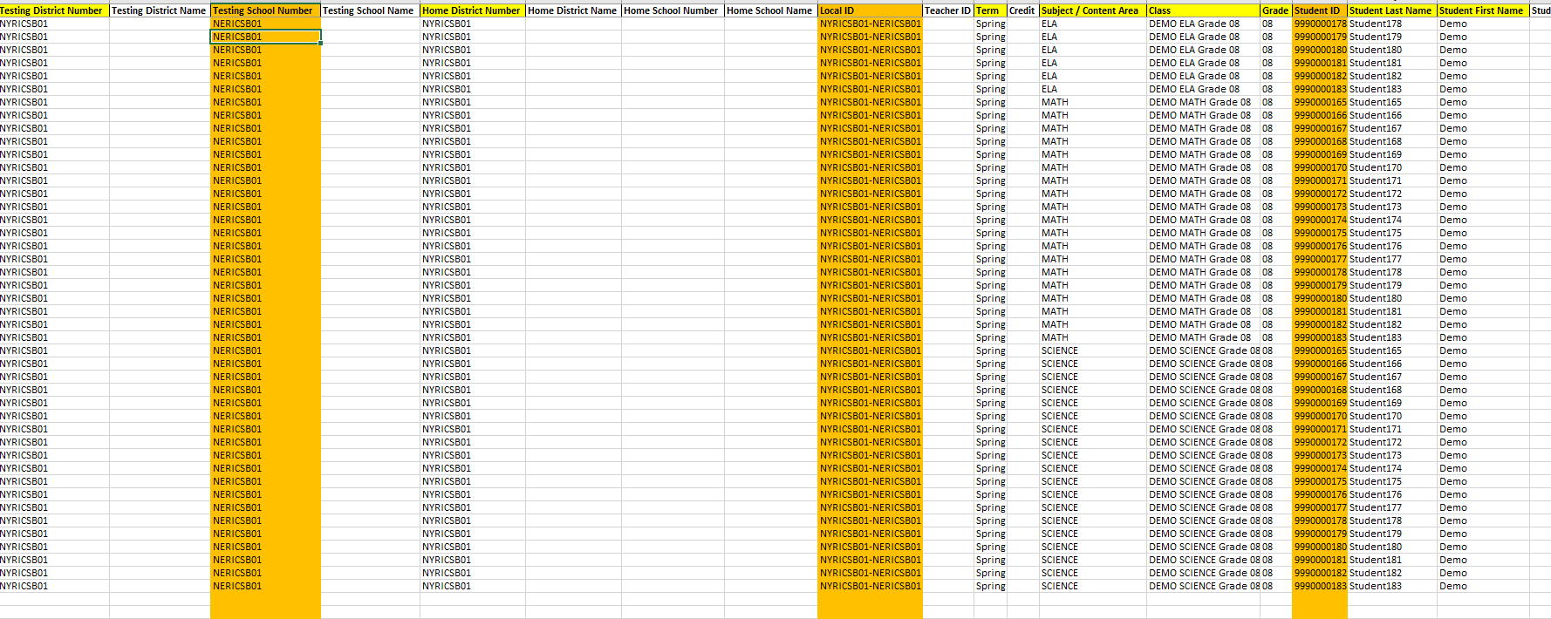
NYSED/NWEA ​Nextera Pre-ID File – NERIC Sandbox
Notes:
NERIC uses the Pre-ID File Format to assist with generating our NY RIC Sandbox for the NERIC Sandbox School.
We use our sandbox as a regional training tool for Nextera Admin to help districts/schools prepare for the Simulation and beyond.
See a recording of our Nextera Admin Training for 2024 here: https://youtu.be/lcdd85F3WZE?si=a52YUzkPeC31XILJ

Slide 8
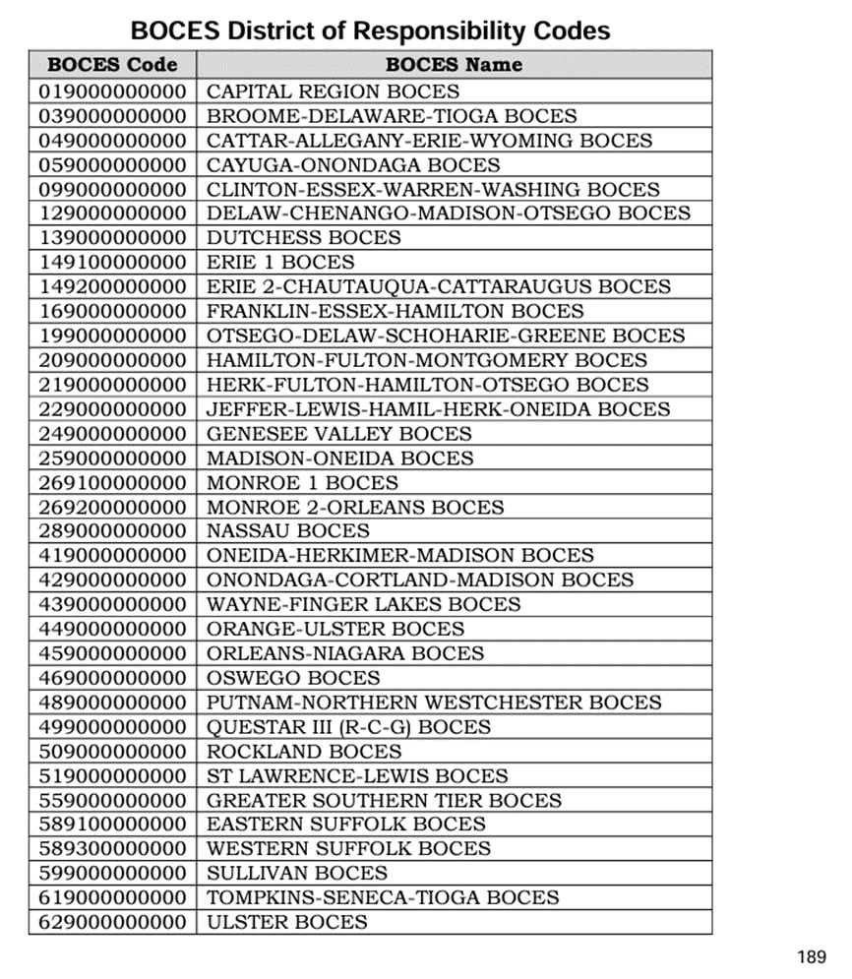
OODP/BOCES Student Data Population
District of Responsibility reports a student with 0011 Enrollment at their OODP/BOCES
The BOCES District of Responsibility Codes found in the SIRS Manual provides the BOCES BEDS Code for reporting
The OODP/BOCES reports the student with 0055 at their locally identified locations
NYSED/NWEA populate all students to their central OODP/BOCES location in Nextera. OODP/BOCES are the "one District/School" *
DTCs/STCs/BLUs can use Classes to arrange students by OODP/BOCES locally identified locations.
Notes:
District of Responsibility reports a student with 0011 Enrollment at their OODP/BOCES -
The BOCES District of Responsibility Codes found in the SIRS Manual provides the BOCES BEDS Code for reporting.
To see what codes your LEAs are using, use Level 0 – Program Services Tab for a student, then look at the Service Provider BEDS Code.
The OODP/BOCES reports the student with 0055 at their locally identified locations – this is how the RIC/Level 1 center can confirm that this student is expected to attend your location. Often we find records are not updated due to a lack of communication between the District of Responsibility and the OODP, and therefore students result in NoMatch records.
NYSED/NWEA populate all students to their central OODP/BOCES location in Nextera. OODP/BOCES are the "one District/School" *
DTCs/STCs/BLUs can use Classes to arrange students by OODP/BOCES locally identified locations. Less is best, but where you have different Principals and STCs doing the work it's important that they are working with their own students. There is a shared responsibility with all of this.

Slide 9
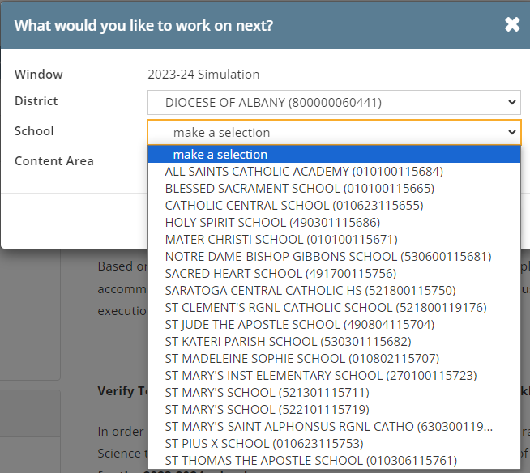
*New for 2024, the Diocese schools and OCFS Locations have been set up as a central District with School locations in Nextera
Notes:
The Diocese and OCFS central administration now have access to their Schools within their hierarchy.
This allows for a more centralized data reporting model, but again the Principal/STC separate ability to be responsible for their students and assessments.
In 2023, each School was a separate entity without the ability for a central Data Person/Administrator to have access to multiple Schools.

Slide 10
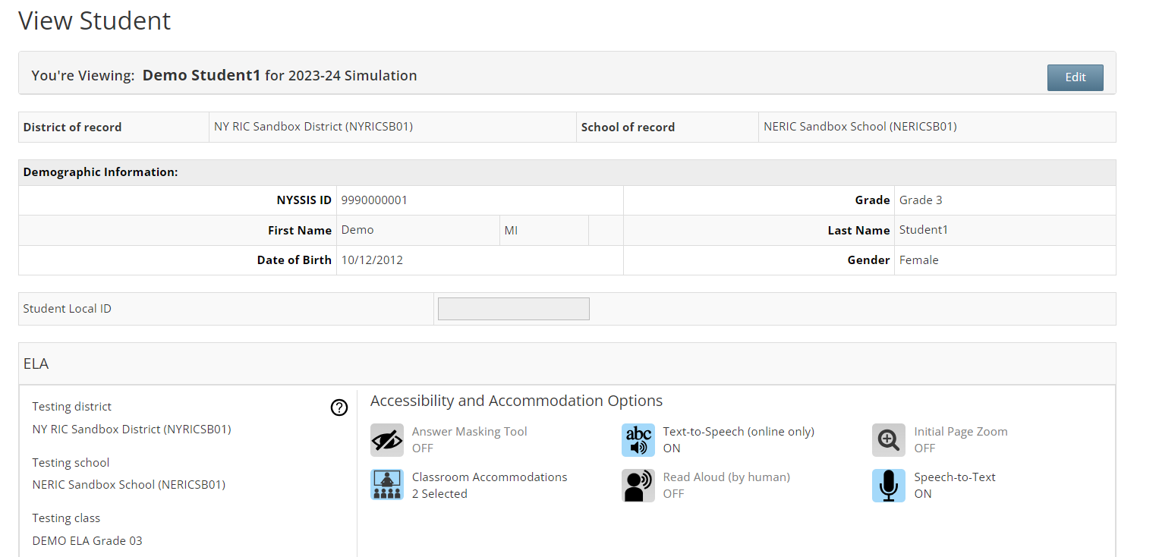
Student Record in Nextera
The wrong NYSSIS can be input here resulting in a NoMatch record
Most cases where grade level has been wrong has been with students found in multigrade classrooms at BOCES locations
Notes:
NYSSIS ID – unique identifier for all students. A student MUST be reported through the Level 0/Level1/Level 2 IRS reporting in order to receive a NYSSIS ID for a student. The wrong NYSSIS can be manually entered resulting in a bad record, or worse a PBT and CBT record for a student attending different districts/schools. It's imperative that extra caution be used for any/all manual entry.
NERIC back fills NYSSIS IDs for our SchoolTool and eSchoolData Districts from our Data Warehouse to the SMS allowing our supported districts easy access to the NYSSIS ID (where provisioned). All other schools can rely on their DDC or our NYSSIS ID Level 1 report for look up.
District of Record and School of Record populate based on the reported record at Level 2. The Testing District and Testing School will match the District/School of Record upon originating import of data.
Grade Level is generated from the Student Demographic Record found at the District of Responsibility. If the School of Instruction has something different, it will not reflect.

Slide 11
Student Transfers
Questions? Contact your local RIC to confirm their process for making these requests
Building to Building within a District
District to District within NY
Student record should be updated via the L0/L1/State Reporting Process
Transfers can be completed by the DTC or DLU within the district
District of Responsibility and Testing District do not change
The School of Record* and the Testing School should be updated accordingly
The School of Record should NOT be changed once a student has begun testing in any subject. Only the Testing School should be updated accordingly.
Student records should be updated at BOTH Districts with respective entry/exit via the L0/L1/State Reporting Process
Transfers can only be done by RIC/SLU (State Level User) Support
District of Responsibility and Testing District will update, depending on whether the student has begun testing.
School of Record and Testing School will update accordingly, depending on whether the student has begun Testing
The Testing District and Testing School will be updated for any/all Subjects that have not yet been completed by the student.
Notes:
Information sourced from the 2023 Quick Reference Guide for moving students. The 2024 edition has not been released, but will include Science as well.
Information about each testing subject must match the assessment record in alignment to changes in the Student Enrollment Profile reported via SIRS.
Any discrepancies will result in an Incomplete Transfer, which if not resolved will result in a NoMatch and Summer Cleanup.

Slide 12
2023 Moving Students QRG
Notes:
This infographic identifies that the District of Record and School or Record MATCH the Testing District and Testing School initially when a student is manually added or imported to Nextera.

Slide 13
2023 Moving Students QRG
Each week, RICs receive an Incomplete Transfers Report which identifies any/all students where there is an inconsistency between the District/School of Record and Testing which needs to be reviewed and updated accordingly.
Notes:
Should a student record need modification due to a transfer between Schools or Districts, it's important that the Testing District and Testing School are kept "locked" where they took the exam.
Again an Incomplete Transfer can arise if the data doesn't match what is found at Level 2 SIRS.

Slide 14
NERIC Sample Shared CBT Transfer Spreadsheet
Subject Codes
SIM – Simulation Transfer
ELA/Math/Sci - Operational Transfer
ELA – Operational ELA
MATH – Operational Math SCI – Operational Science
SAFT – Stand Alone Field Testing Transfer
NERIC verifies Entry/Exit dates using Level 0/Level 1 data for any overlaps or missing information prior to performing any transfer. This has reduced the number of Incomplete Transfers and Data Warehouse Errors.
Fun fact – for 2023, NERIC performed 339 transfers for all administrations... we have already surpassed 108 transfers for the 2024 Simulation alone.
Notes:
At NERIC we track EVERY transfer we perform for our districts. This is the template we use and the file is shared securly in our O365 environment.
We verify Entry/Exit for each student using our Data Warehouse access and/or coordinate with other Statewide RIC/Level 1 centers to confirm cross-state transfers.
To identify who to contact, use the RICS/Big 5 listing found on CBT support https://cbtsupport.nysed.gov/hc/en-us/articles/360016363112-How-do-I-contact-my-Regional-Information-Center-RIC-or-Big-5-District-Testing-Department

Slide 15
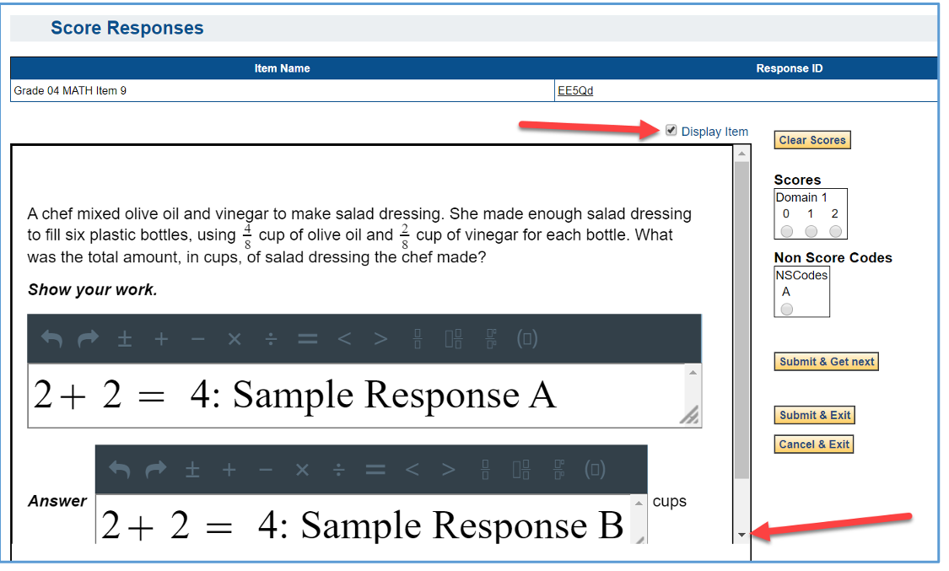
Scoring of Student Responses
The Testing School is linked to the SED Code for the Lead Scoring Entity identified during the ordering process.
Upon completion of the exam, student response data flows to the Lead Scoring Entity anonymously using ScorePoint for scoring.
Scored data is returned to NWEA, completing the student assessment record.
Notes:
The Lead Scoring Entity is collected during the 3 – 8 ELA/Math/Science ordering window. This is the Scoring Site (3rd party vendor, BOCES, Scoring Consortium etc.) that the School plans to use for scoring in accordance with the scoring model rules.
Scoring Models are different for CBT than PBT and as a result some of our smaller LEAs are no longer able to score their own exams without partnering with another LEA.
ScorePoint is the system used to apply scores to the Constructed Response questions from the exams. All students are anonymous to the scorers, unless something in the response identifies who the student is.
Data feeds from ScorePoint back to NWEA to complete the student assessment record. Student Constructed Responses in CBT can be accessed in Nextera once the administration is finalized. Find out more about how here: https://cbtsupport.nysed.gov/hc/en-us/articles/115003215303-How-can-parents-view-their-student-s-Constructed-Responses-CRs-for-CBT

Slide 16
Return of Assessment Data to DW
CBT CR Data goes to Lead Scoring Entity
Districts/Schools have access to Assessment Data
Answer Sheet Data
Lead Scoring Entity Scores CR and Returns
Processing System (NTSS)
NYSED/NWEA Combine PBT/CBT Data and Finalize Scores –Load to SIRS 301
Import Finalized Assessment Files into DW
This process is repeated WEEKLY as needed until all data is finalized
Export to DW
Import Finalized Assessment Files into DW
DW load to M2L1C - NYSED
NYSED/NWEA Combine PBT/CBT Data and Finalize Scores –Load to SIRS 301
Districts/Schools have access to Assessment Data
Notes:
The method at which PBT data has to flow to NYSED then back to the RIC/Level 1 center is much more cumbersome than the flow of CBT data to the RIC/Level 1 center.
As more and more students transition to CBT, it is my hope that the turn around of instructional data and scores is expedited in a faster manner.
Other factors of this include, but are not limited to, changes to the Standards, test design and/or systems used for CBT administration.

Slide 17
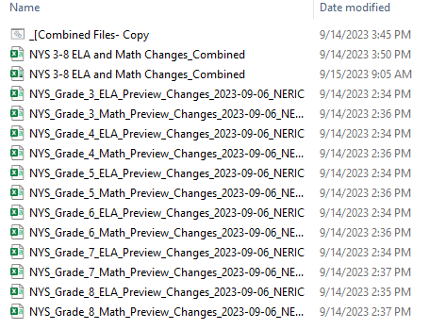
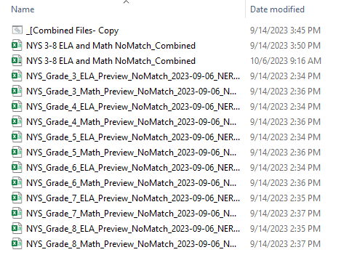
Changes, Duplicates & No Matches
Duplicates and NoMatch records are Summer Cleanup
Changes are reviewed for accuracy, but no further action is generally required.
Notes:
As mentioned earlier, a student assessment record can become a NoMatch for Level 2 IRS or unable to be attached to a specific student/district/school.
There are also Duplicates and Changes.
Duplicates occur when there are 2 schools that report records for a student and the correct District/School of Record must be confirmed. We often see this if one school reports a refusal for a student, then the student transfers to a new School and takes the exam but the District/School of Record doesn't match the Testing District/School resulting in both records being reported... it's like 2 different answer sheets for a student.
Changes are situations where Level 2 SIRS noted discrepancies in the District/School of Record and Testing District/School but using the correctly reported demo/enrollment records they are able to resolve the conflict before sending the record back to the RIC/Level 1 center. While these should report without error, our RIC reviews and confirms all data in our Data Warehouse to make sure the LEAs have no data issues before close of the DW for the year.

Slide 18
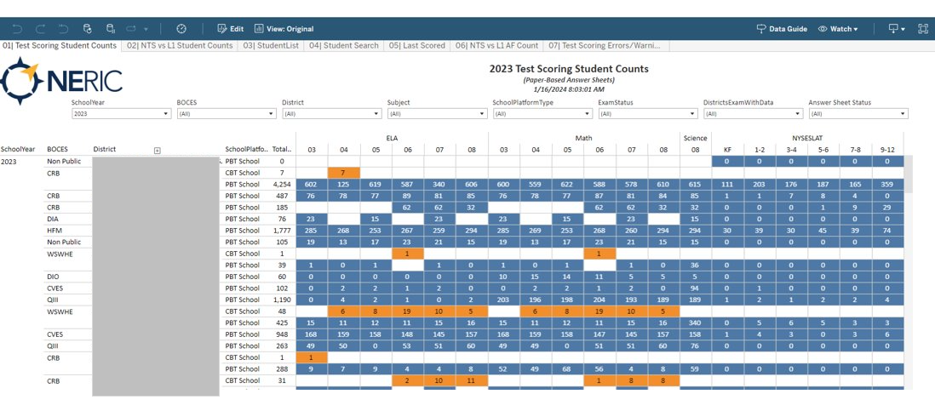
Other Reports NERIC uses Internally
Notes:
Test Scoring Student Counts – connecting to our instance of Test Scoring, we are able to provide reports wholistically for our RIC to identify counts of PBT answer sheets for Districts/Schools. It highlights where CBT is being administered as well as if there are requests for printed PBT answer sheets in a CBT school. We hold our LEAs 100% accountable to any/all answer sheets printed. With ELLs mostly testing on paper for 2024 this will be especially important to keep track of schools.

Slide 19
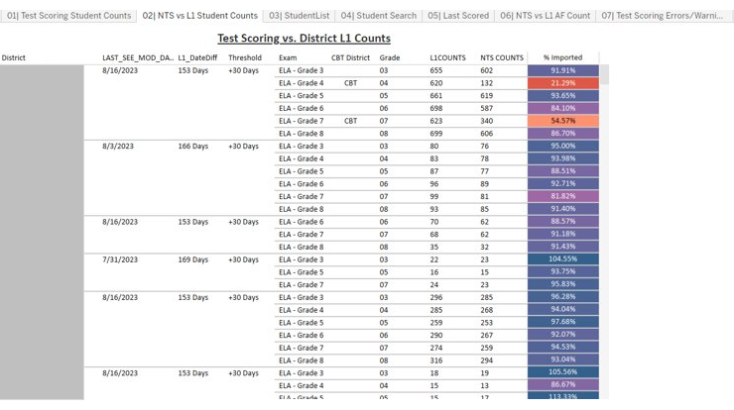
Other Reports NERIC uses Internally
Notes:
Test Scoring vs. District L1 Counts – this report provides us a comparison of the L1 DW Student Counts in comparison to how many students are imported into our Test Scoring System. Discrepancies noted using the heatmap coloring quickly help us confirm that we have identified CBT schools/grades accordingly and who we need to cross check against OSA order reports.

Slide 20
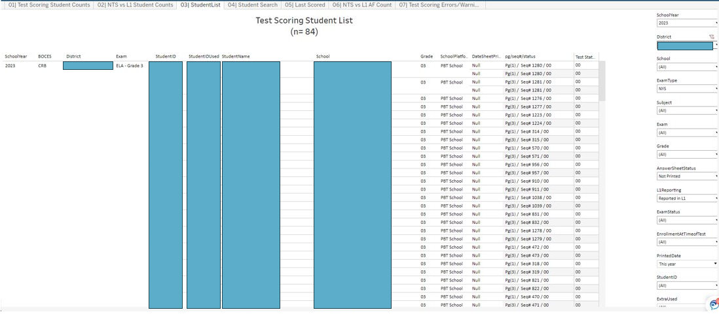
Other Reports NERIC uses Internally
Notes:
The Testing Scoring Student List provides us a listing of all of the preprinted PBT answer sheets by District/School/Grade/Subject. As answer sheets are scanned, the scan sequence number updates.
The Test Status identifies a Reason Not Tested Code denoted.

Slide 21
Other Reports NERIC uses Internally
Notes:
Test Scoring Student Search – using the Local ID for a student we are able to search out any/all records aligned to that Student ID. This particular report also includes the Extended Response Scores matched to a student in addition to the Sequence Number and Testing Status.
This has allowed us to notice students without CR data, or with inconsistent data, from 3rd party vendors using data files in lieu of PBT answer sheets.

Slide 22
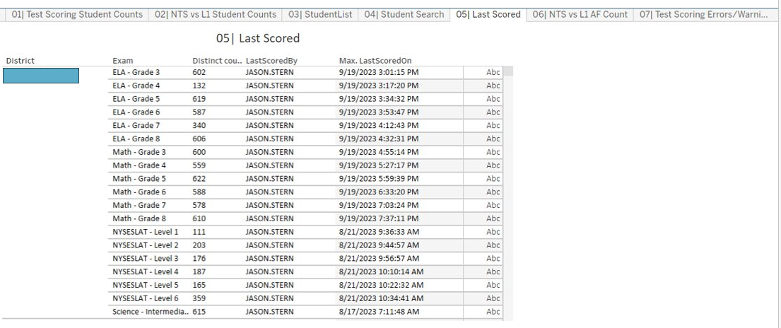
Other Reports NERIC uses Internally
Notes:
Last Scored – several years ago there was a non-public school that went unscored in our system because we received NO ANSWER SHEETs back from them.
There was an oversight, and the School wasn't reported as missing. A processor never processed the batch, finalizing the score, which would have told us Missing Data.
This report now allows us to run who Last Scores all expected batches in the system. The Last Scored By will represent the processor that last worked on the batch allowing a system of accountability.

Slide 23
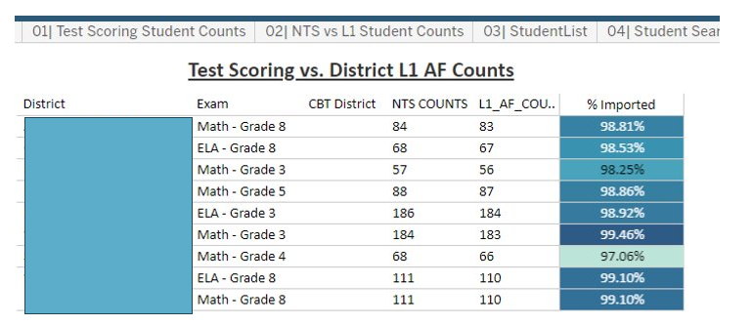
Other Reports NERIC uses Internally
Notes:
L1 AF count is the number of Assessment Fact Records in L1 for that assessment. It helps find discrepancies where records in NTS don't match L1.
Typically the missing records end up being a DW error needing resolve by the District/School.

Slide 24
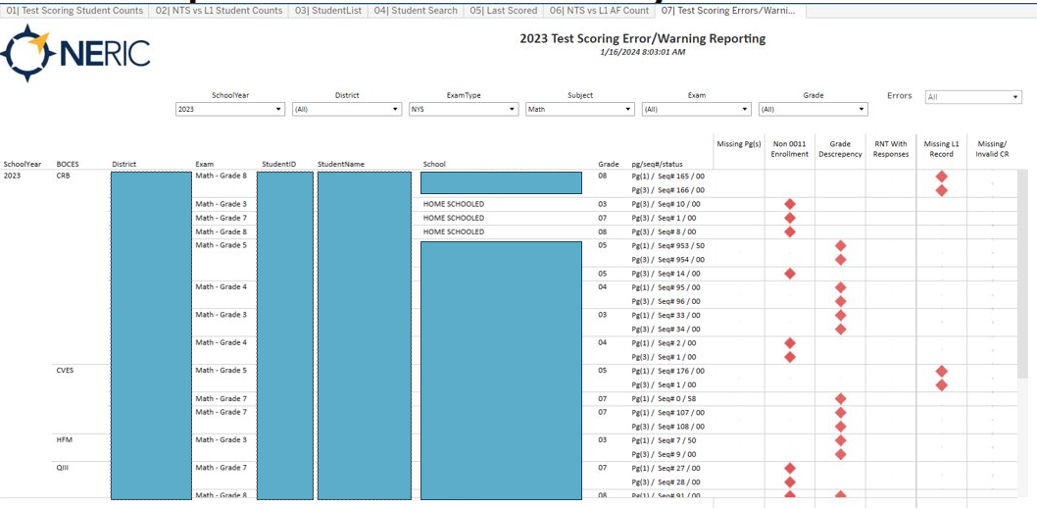
Other Reports NERIC uses Internally
Notes:
Our Test Scoring Error/Warning Reporting report allows us to see specific students who...
- are not reported to L1 with 0011 but have an answer sheet (student may be a 0055 or 5905 etc.)
-Have a grade discrepancy – Ungraded 13 but has a Grade 5 exam
-RNT Code with Responses – this will show for any student with an Absent, Refusal, Taking Regents etc. And student responses are found in the data
-Missing L1 Record – student is completely missing from the Data Warehouse
-Missing/Invalid CR – will identify students where CR scores are expected but missing.

Slide 25
Thank you
Anne Marie Bertram
Testing & Data Reports Manager
Annemarie.Bertram@neric.org

